Slide 1
Optimal Control Theory Parallel Parking with Collision Avoidance for Four-wheeled Vehicles
DEPARTMENT OR ENGINEERING | 04/22/2020

Slide 2
Agenda
Introduction
Technical Background
Optimization Problem
Model & Focus
Dynamics
Approach
Collision Avoidance
Results
Conclusions
Future Improvements

Slide 3
Introduction
Vehicular Automation
Usage of Mechatronics, AI, and Multi-agent system
Application
Autopilot
Navigation
Automatic drive

Slide 4
Technical Background
Existing technologies for the parallel parking is limited.
Codes and programs are mostly simple simulation.
The main body of the vehicle collides into walls and objects.
Parallel parking is not an optimal problem.
Limited involvement in optimizing cost.
More involvement in trajectory planning.

Slide 5
Model & Focus
Parallel parking
Common and universal behavior of vehicles
Part of the self-piloting of vehicles
Four-wheeled Automobile Simulation
Represented and simulated as a rectangle
Vertices represent four wheels respectively

Slide 6
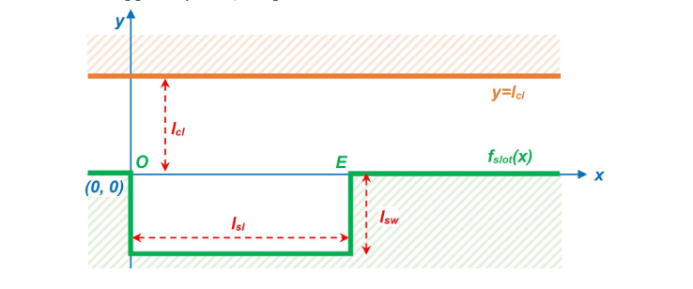

Model & Focus
Representation of a parking slot
Parameters that visualize a slot in a cartesian frame:
$l_{sl}:length of slot$
$l_{sw}:depth of slot$
$l_{cl}:width of road$
Behavior of vehicle:
Vehicle is moving in x direction
Perform parallel parking at the slot

Slide 7
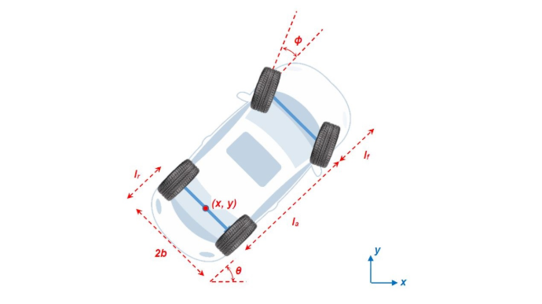
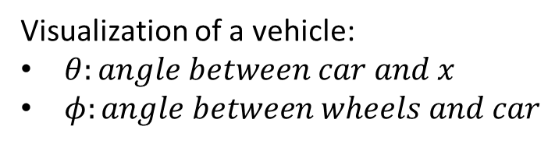
Model & Focus
Representation of a vehicle
Visualization of a vehicle:
$θ:angle between car and x$
$φ:angle between wheels and car$

Slide 8
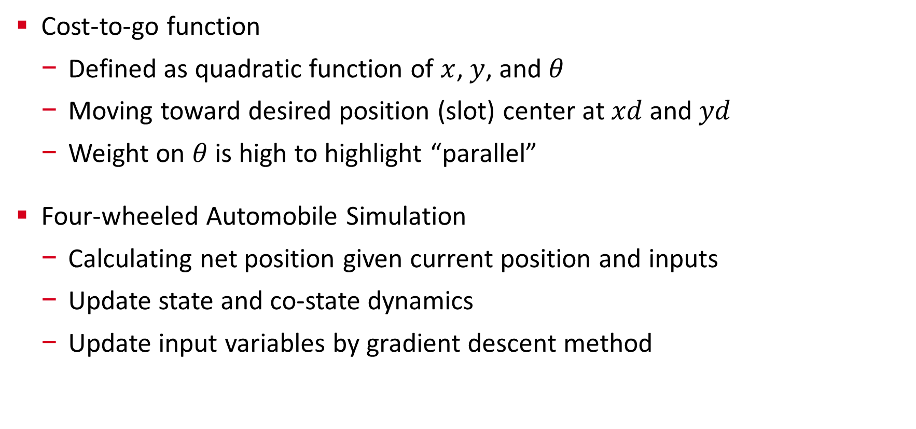
Dynamics
Cost-to-go function
Defined as quadratic function of $x$, $y$, and $θ$
Moving toward desired position (slot) center at $xd$ and $yd$
Weight on $θ$ is high to highlight “parallel”
Four-wheeled Automobile Simulation
Calculating net position given current position and inputs
Update state and co-state dynamics
Update input variables by gradient descent method

Slide 9
Approach

Slide 10
Collision Avoidance

Slide 11
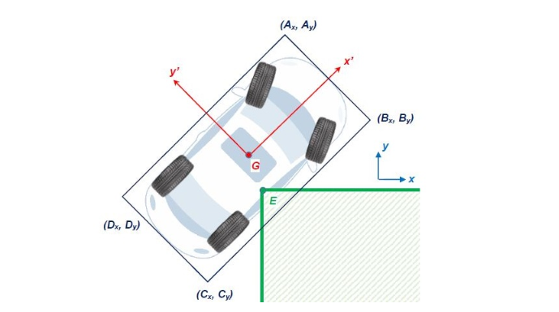
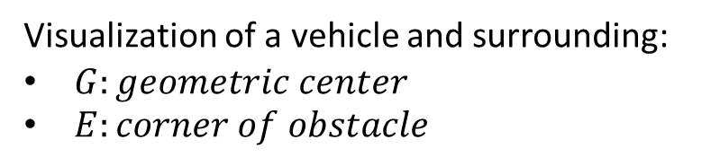
Model & Focus
Undesired behavior of a vehicle
Visualization of a vehicle and surrounding:
$G:geometric center$
$E:corner of obstacle$

Slide 12
Results

Slide 13
Conclusions
Optimized motion towards a desired position
Constrained optimization
Simplified simulation of parallel parking process

Slide 14
Future Improvements
Smaller slot – if a solution is possible
Research on reverse parking
Different physical models and dynamics
Take more complex system into consideration
Parking slot located at ramps
Optimization variables can be much more complex in real cases
Complex feedback system for a real automobiles

Slide 15
Q&A
Any Questions?

